Slide 1

CS 2114 · FALL 2026 · WEEK 1
Software Design & Data Structures
Virginia Tech · Department of Computer Science
1 / 28

Slide 2
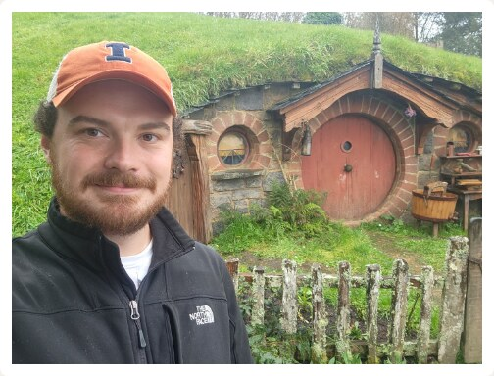
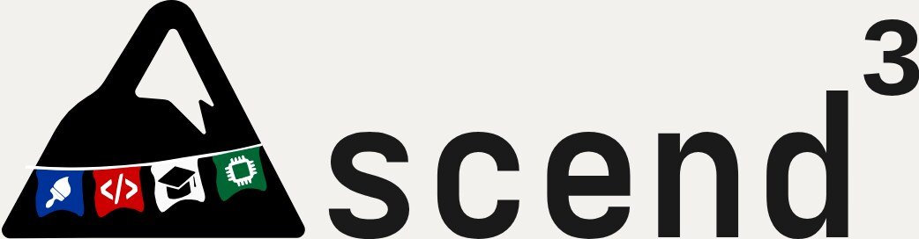




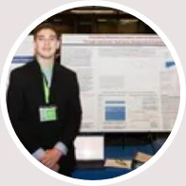


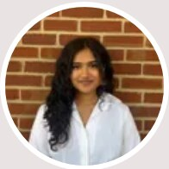

David H. Smith IV
Assistant Professor
DEPARTMENT OF COMPUTER SCIENCE
Advancing
Learning Sciences, Cognitive Science & Educational Psychology
Support in
Computing
Moonwara
Fariha
Education for
Novice
Computing Education Research
Minsun
Hudson
Developers
Data Scientists
Human–Computer Interaction
Designers
Ben
Vanshika
2 / 28

Slide 3
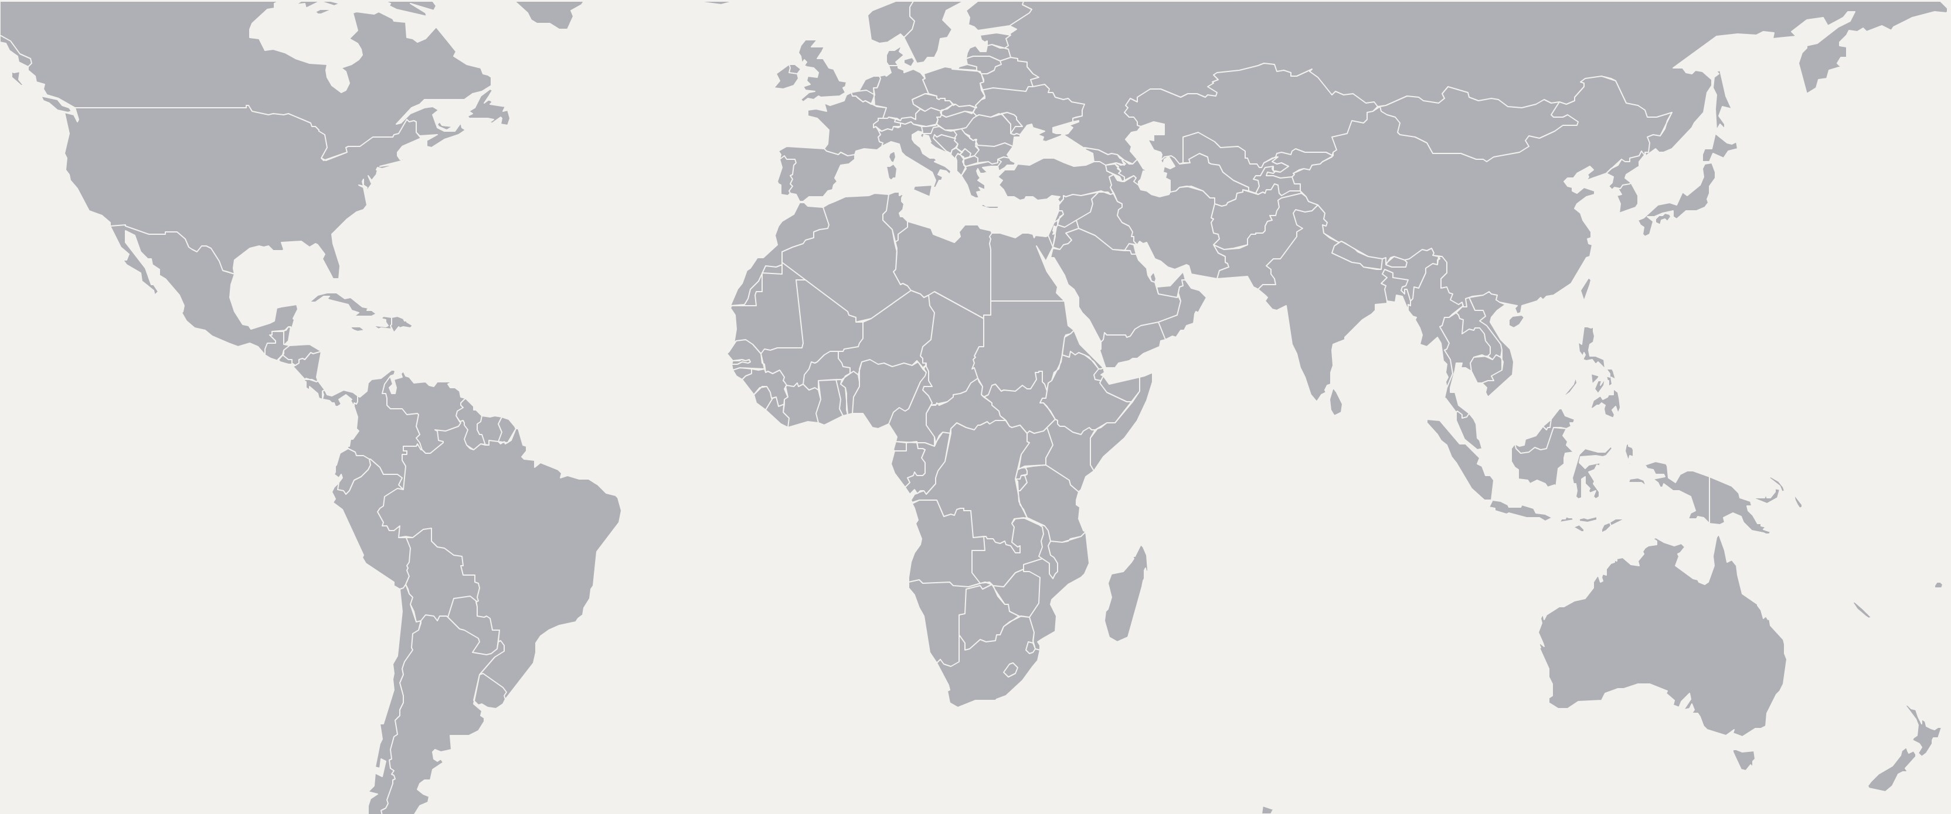
PERKS OF THE JOB AND MY FAVORITE HOBBY: TRAVEL!
3 / 28

Slide 4
PERKS OF THE JOB AND MY FAVORITE HOBBY: TRAVEL!
3 / 28

Slide 5
Software Design &
Data Structures
4 / 28

Slide 6

Software Design &
Data Structures
Writing
4 / 28

Slide 7

Software Design &
Data Structures
Writing
Testing
4 / 28

Slide 8

Data Structures
Software Design &
Writing
Testing
Tracing
4 / 28

Slide 9

Data Structures
Software Design &
Writing
Testing
Tracing
Debugging
4 / 28

Slide 10

Data Structures
Software Design &
Writing
Testing
Tracing
Debugging
Reading code
4 / 28

Slide 11
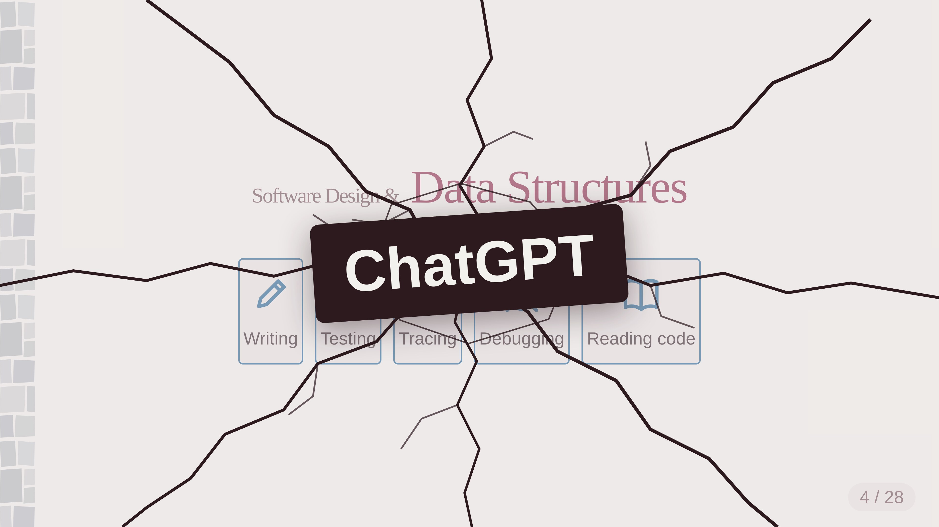





Data Structures
Software Design &
ChatGPT
Writing
Testing
Tracing
Debugging
Reading code
4 / 28

Slide 12
Data Structures
Software Design &
Writing
Testing
Tracing
Debugging
Reading code
4 / 28

Slide 13






Software Design &
Data Structures
Writing
Testing
Tracing
Debugging
Reading code
Design
Decomposition
4 / 28

Slide 14

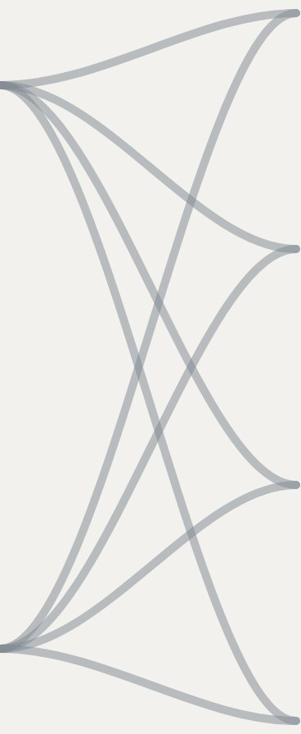



Design skills + Engineering skills
Design-oriented
Open-ended collaborative projects
Choosing what to build — and why
Homework & challenge problems
Exams
Implementation-oriented
Building it well — and proving it
Peer instruction
5 / 28
Notes:
Every assessment touches both columns — the emphasis in the open-ended projects is on the design-oriented skills; homework, exams, and peer instruction lean on the engineering side.

Slide 15
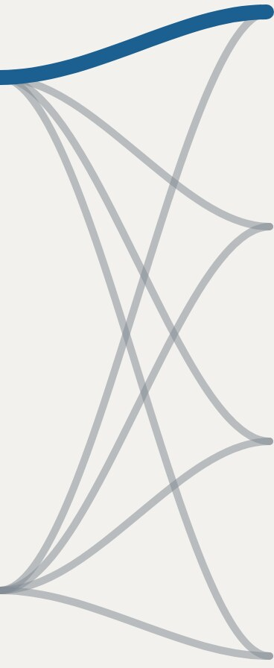

Design skills + Engineering skills
Design-oriented
Open-ended collaborative projects
Choosing what to build — and why
Homework & challenge problems
Exams
Implementation-oriented
Building it well — and proving it
Peer instruction
5 / 28
Notes:
Every assessment touches both columns — the emphasis in the open-ended projects is on the design-oriented skills; homework, exams, and peer instruction lean on the engineering side.

Slide 16
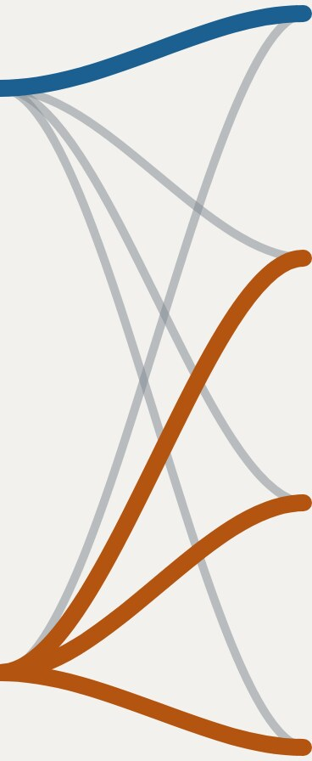

Design skills + Engineering skills
Design-oriented
Open-ended collaborative projects
Choosing what to build — and why
Homework & challenge problems
Exams
Implementation-oriented
Building it well — and proving it
Peer instruction
5 / 28
Notes:
Every assessment touches both columns — the emphasis in the open-ended projects is on the design-oriented skills; homework, exams, and peer instruction lean on the engineering side.

Slide 17
What’s different this year
UNTIL THIS YEAR
FALL 2026
Readings & practice
Course content in one place, code practice in another.
Projects
A spec we wrote for you, completed on your own.
6 / 28
Notes:
Be straight about this: neither piece is a polished, road-tested system. Say plainly that we expect to change things mid-semester, and that we’d rather hear it early than at the end.

Slide 18

What’s different this year
UNTIL THIS YEAR
FALL 2026
Readings & practice
PrairieLearn
Course content in one place, code practice in another.
Readings and code exercises in one place, with feedback while you work.
Projects
A spec we wrote for you, completed on your own.
6 / 28
Notes:
Be straight about this: neither piece is a polished, road-tested system. Say plainly that we expect to change things mid-semester, and that we’d rather hear it early than at the end.

Slide 19

What’s different this year
UNTIL THIS YEAR
FALL 2026
Readings & practice
PrairieLearn
Course content in one place, code practice in another.
Readings and code exercises in one place, with feedback while you work.
Projects
Open-ended & collaborative
A spec we wrote for you, completed on your own.
You scope the problem and build it as a team — the spec is yours to write.
6 / 28
Notes:
Be straight about this: neither piece is a polished, road-tested system. Say plainly that we expect to change things mid-semester, and that we’d rather hear it early than at the end.

Slide 20
What’s different this year
UNTIL THIS YEAR
FALL 2026
Readings & practice
PrairieLearn
Course content in one place, code practice in another.
Readings and code exercises in one place, with feedback while you work.
Projects
Open-ended & collaborative
A spec we wrote for you, completed on your own.
You scope the problem and build it as a team — the spec is yours to write.
New for you — and new for us. We’ll be evaluating it together.
6 / 28
Notes:
Be straight about this: neither piece is a polished, road-tested system. Say plainly that we expect to change things mid-semester, and that we’d rather hear it early than at the end.

Slide 21
We’re researching this, too
7 / 28
Notes:
Two strands, one purpose. Name the TA research explicitly — students rarely hear that the staff are being supported too. Promise to share what we find; that promise is the reason the room should care.

Slide 22
We’re researching this, too
With you
Your experience
Surveys, interviews, and how you actually move through the modules — what helps, and what gets in the way.
7 / 28
Notes:
Two strands, one purpose. Name the TA research explicitly — students rarely hear that the staff are being supported too. Promise to share what we find; that promise is the reason the room should care.

Slide 23
We’re researching this, too
With you
With our TAs
Your experience
Support for our TAs
Surveys, interviews, and how you actually move through the modules — what helps, and what gets in the way.
What TAs need in order to help you well — in lab, and in office hours.
7 / 28
Notes:
Two strands, one purpose. Name the TA research explicitly — students rarely hear that the staff are being supported too. Promise to share what we find; that promise is the reason the room should care.

Slide 24
We’re researching this, too
With you
With our TAs
Your experience
Support for our TAs
Surveys, interviews, and how you actually move through the modules — what helps, and what gets in the way.
What TAs need in order to help you well — in lab, and in office hours.
A better GenAI-forward CS 2114
Everything we learn feeds the next version of this course — you’re part of the design, not just the class.
7 / 28
Notes:
Two strands, one purpose. Name the TA research explicitly — students rarely hear that the staff are being supported too. Promise to share what we find; that promise is the reason the room should care.

Slide 25

So… what will the semester look like?
8 / 28
Notes:
Pause here. Let the question sit before the semester map answers it.

Slide 26
The semester at a glance
Aug
Sep
Oct
Nov
Dec
1
2
3
4
5
6
7
8
9
10
11
12
13
Break
14
15
16
9 / 28

Slide 27
The semester at a glance
Aug
Sep
Oct
Nov
Dec
1
2
3
4
5
6
7
8
9
10
11
12
13
Break
14
15
16
Wk 1–2
Java foundations — testing, exceptions, polymorphism
9 / 28

Slide 28
The semester at a glance
Aug
Sep
Oct
Nov
Dec
1
2
3
4
5
6
7
8
9
10
11
12
13
Break
14
15
16
Wk 1–2
Java foundations — testing, exceptions, polymorphism
Wk 3–5
Bags, linked chains, efficiency, stacks · Test 1 Wk 5
P1
9 / 28

Slide 29
The semester at a glance
Aug
Sep
Oct
Nov
Dec
1
2
3
4
5
6
7
8
9
10
11
12
13
Break
14
15
16
Wk 1–2
Java foundations — testing, exceptions, polymorphism
Wk 3–5
Bags, linked chains, efficiency, stacks · Test 1 Wk 5
P1
Wk 6–9
Ethics & MVC, recursion, queues, lists · Test 1 redo Wk 6
P2
9 / 28

Slide 30
The semester at a glance
Aug
Sep
Oct
Nov
Dec
1
2
3
4
5
6
7
8
9
10
11
12
13
Break
14
15
16
Wk 1–2
Java foundations — testing, exceptions, polymorphism
Wk 3–5
Bags, linked chains, efficiency, stacks · Test 1 Wk 5
P1
Wk 6–9
Ethics & MVC, recursion, queues, lists · Test 1 redo Wk 6
P2
Wk 10–13
Sorting, sorted lists, trees · Test 2 Wk 10 · redo Wk 11
P3
9 / 28

Slide 31
The semester at a glance
Aug
Sep
Oct
Nov
Dec
1
2
3
4
5
6
7
8
9
10
11
12
13
Break
14
15
16
Wk 1–2
Java foundations — testing, exceptions, polymorphism
Wk 3–5
Bags, linked chains, efficiency, stacks · Test 1 Wk 5
P1
Wk 6–9
Ethics & MVC, recursion, queues, lists · Test 1 redo Wk 6
P2
Wk 10–13
Sorting, sorted lists, trees · Test 2 Wk 10 · redo Wk 11
P3
Wk 14–15
Binary search, BSTs, review — classes end Dec 9
P3 demo
9 / 28

Slide 32
The semester at a glance
Aug
Sep
Oct
Nov
Dec
1
2
3
4
5
6
7
8
9
10
11
12
13
Break
14
15
16
Wk 1–2
Java foundations — testing, exceptions, polymorphism
Wk 3–5
Bags, linked chains, efficiency, stacks · Test 1 Wk 5
P1
Wk 6–9
Ethics & MVC, recursion, queues, lists · Test 1 redo Wk 6
P2
Wk 10–13
Sorting, sorted lists, trees · Test 2 Wk 10 · redo Wk 11
P3
Wk 14–15
Binary search, BSTs, review — classes end Dec 9
P3 demo
Wk 16
Final exam · Dec 11–16 · Good luck, Hokies!!!
9 / 28

Slide 33
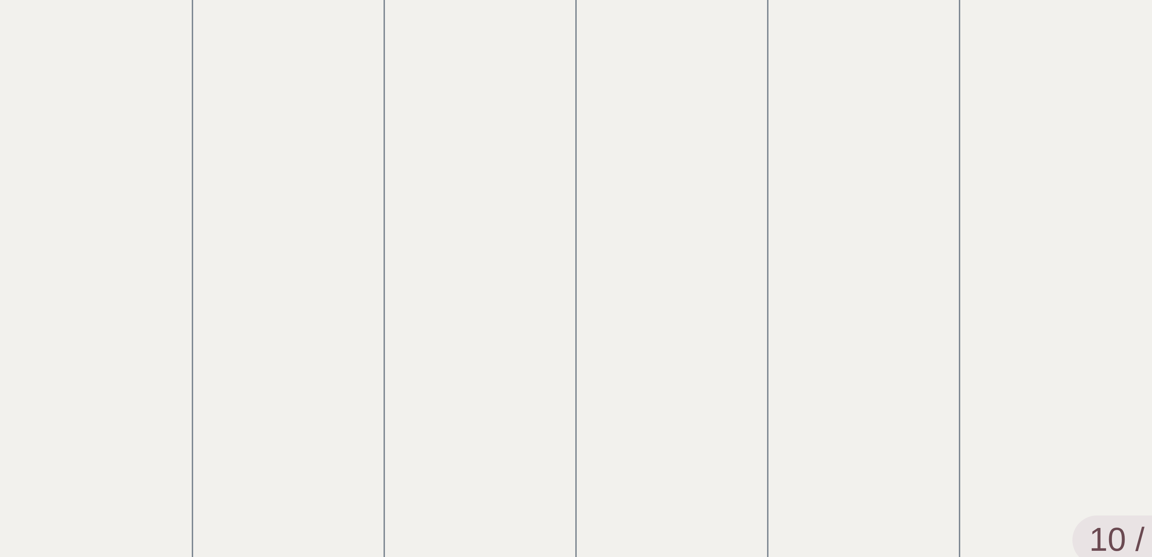
Your week in a nutshell
Sun
Mon · lecture
Tue
Wed · lecture
Thu
Fri
10 / 28

Slide 34
Your week in a nutshell
Sun
Mon · lecture
Tue
Wed · lecture
Thu
Fri
Study
PrairieLearn modules + exercises, due each Sunday.
10 / 28

Slide 35
Your week in a nutshell
Sun
Mon · lecture
Tue
Wed · lecture
Thu
Fri
Study
PrairieLearn modules + exercises, due each Sunday.
Peer instruction
In every lecture, to earn credit.
10 / 28

Slide 36
Your week in a nutshell
Sun
Mon · lecture
Tue
Wed · lecture
Thu
Fri
Study
PrairieLearn modules + exercises, due each Sunday.
Peer instruction
In every lecture, to earn credit.
Homework & challenge
Weekly homework + lab challenge exercise — due Friday.
10 / 28

Slide 37
Your week in a nutshell
Sun
Mon · lecture
Tue
Wed · lecture
Thu
Fri
Study
PrairieLearn modules + exercises, due each Sunday.
Peer instruction
In every lecture, to earn credit.
Homework & challenge
Weekly homework + lab challenge exercise — due Friday.
Project deliverables
Uploaded before your lab time, whichever day yours meets.
10 / 28

Slide 38
The Project Structure
P1
P2
P3
Core
Java + Exceptions
Generic Bag<T>
Queue + MVC
Weeks
3–5
6–9
10–15
Teams
Assigned, 3–4
Re-form, 3–4
Re-form, 3–4
Deliverables
Scope · Spec · Final
+ Prototype + Tests
+ Second prototype
Lesson
Define before you build
Clear contracts make reuse cheap
Good boundaries absorb change
11 / 28

Slide 39
The Project Structure
P1
P2
P3
Core
Java + Exceptions
Generic Bag<T>
Queue + MVC
Weeks
3–5
6–9
10–15
Teams
Assigned, 3–4
Re-form, 3–4
Re-form, 3–4
Deliverables
Scope · Spec · Final
+ Prototype + Tests
+ Second prototype
Lesson
Define before you build
Clear contracts make reuse cheap
Good boundaries absorb change
11 / 28

Slide 40
The Project Structure
P1
P2
P3
Core
Java + Exceptions
Generic Bag<T>
Queue + MVC
Weeks
3–5
6–9
10–15
Teams
Assigned, 3–4
Re-form, 3–4
Re-form, 3–4
Deliverables
Scope · Spec · Final
+ Prototype + Tests
+ Second prototype
Lesson
Define before you build
Clear contracts make reuse cheap
Good boundaries absorb change
11 / 28

Slide 41
The Project Structure
P1
P2
P3
Core
Java + Exceptions
Generic Bag<T>
Queue + MVC
Weeks
3–5
6–9
10–15
Teams
Assigned, 3–4
Re-form, 3–4
Re-form, 3–4
Deliverables
Scope · Spec · Final
+ Prototype + Tests
+ Second prototype
Lesson
Define before you build
Clear contracts make reuse cheap
Good boundaries absorb change
11 / 28

Slide 42
Grading: Per Deliverable, EMRN Rubric
E · Exceeds
M · Meets
10 pts
8.5 pts
Beyond Meets, notably strong.
Does what’s asked, done well. The target.
Delete asks first — and offers undo.
Tap delete — the task is gone.
R · Revisable
N · Not Yet
7.5 pt
5 pts
Close — fix it in the revision window.
Not enough to assess yet.
Deletes, but the count goes stale.
Tap delete… chirp… chirp…
12 / 28

Slide 43
Grading: Per Deliverable, EMRN Rubric
E · Exceeds
M · Meets
10 pts
8.5 pts
Beyond Meets, notably strong.
Does what’s asked, done well. The target.
Delete asks first — and offers undo.
Tap delete — the task is gone.
R · Revisable
N · Not Yet
7.5 pt
5 pts
Close — fix it in the revision window.
Not enough to assess yet.
Deletes, but the count goes stale.
Tap delete… chirp… chirp…
Note: If you get R and N on a rubric item your team may address it in the next deliverable and get it raised to a "Meets".
12 / 28

Slide 44






Tools
PrairieLearn
Canvas
Piazza
Content modules, homework, challenge exercises
Schedule, deadlines, project submissions
Q&A — turn on Instructor-post notifications
GitHub
Eclipse
Web-CAT
Team collaboration, version control, project code
Java IDE — setup is Challenge Exercise 01
Automated grading for projects
13 / 28

Slide 45
GenAI: use it and use it well
Encouraged
Explaining concepts and errors
Debugging hints
Boilerplate and syntax recall
Brainstorming
14 / 28

Slide 46
GenAI: use it and use it well
Encouraged
What does “NullPointerException at Node.getNext()” mean?
Explaining concepts and errors
Debugging hints
✻
You called getNext() on a variable that never got a Node — check where firstNode is assigned.
Boilerplate and syntax recall
Brainstorming
14 / 28

Slide 47
GenAI: use it and use it well
Encouraged
What does “NullPointerException at Node.getNext()” mean?
My loop prints the last name five times. Hint only — no fix!
Explaining concepts and errors
Debugging hints
✻
✻
You called getNext() on a variable that never got a Node — check where firstNode is assigned.
Print i and names[i] each pass — watch what the inner loop actually changes.
Boilerplate and syntax recall
Brainstorming
14 / 28

Slide 48
GenAI: use it and use it well
Encouraged
What does “NullPointerException at Node.getNext()” mean?
My loop prints the last name five times. Hint only — no fix!
Generic method that returns T?
Explaining concepts and errors
✻
Like this:
Debugging hints
✻
✻
You called getNext() on a variable that never got a Node — check where firstNode is assigned.
Print i and names[i] each pass — watch what the inner loop actually changes.
Boilerplate and syntax recall
public <T> Tfirst(List<T> xs) {
return xs.get(0);
}
Brainstorming
14 / 28

Slide 49
GenAI: use it and use it well
Encouraged
What does “NullPointerException at Node.getNext()” mean?
My loop prints the last name five times. Hint only — no fix!
What classes for Minesweeper?
Generic method that returns T?
Explaining concepts and errors
✻
✻
Like this:
Maybe Board, Cell, Game for the rules, TextUI to draw. What else?
Debugging hints
✻
✻
You called getNext() on a variable that never got a Node — check where firstNode is assigned.
Print i and names[i] each pass — watch what the inner loop actually changes.
Boilerplate and syntax recall
public <T> Tfirst(List<T> xs) {
return xs.get(0);
}
Brainstorming
A Timer! And maybe Difficulty.
14 / 28

Slide 50
GenAI: use it and use it well
Encouraged
What does “NullPointerException at Node.getNext()” mean?
My loop prints the last name five times. Hint only — no fix!
What classes for Minesweeper?
Generic method that returns T?
Explaining concepts and errors
✻
✻
Like this:
Maybe Board, Cell, Game for the rules, TextUI to draw. What else?
Debugging hints
✻
✻
You called getNext() on a variable that never got a Node — check where firstNode is assigned.
Print i and names[i] each pass — watch what the inner loop actually changes.
Boilerplate and syntax recall
public <T> Tfirst(List<T> xs) {
return xs.get(0);
}
Brainstorming
A Timer! And maybe Difficulty.
Note: We won’t be restricting GenAI use in this course — but failing to learn the concepts independently will show up in your exam score!
14 / 28

Slide 51
This week
15 / 28

Slide 52
This week
PrairieLearn · before each lecture
Modules 1.1–1.5
Welcome · Environment Setup · Java Fundamentals · Unit Testing · Style & Docs
15 / 28

Slide 53
This week
PrairieLearn · before each lecture
PrairieLearn · due Friday
Modules 1.1–1.5
Homework: Week 1 Intro
Welcome · Environment Setup · Java Fundamentals · Unit Testing · Style & Docs
Your first graded assignment.
15 / 28

Slide 54
This week
PrairieLearn · before each lecture
PrairieLearn · due Friday
Modules 1.1–1.5
Homework: Week 1 Intro
Welcome · Environment Setup · Java Fundamentals · Unit Testing · Style & Docs
Your first graded assignment.
Lab challenge · due Friday
Challenge Exercise 01
Eclipse setup — get the toolchain running.
15 / 28

Slide 55
This week
PrairieLearn · before each lecture
PrairieLearn · due Friday
Modules 1.1–1.5
Homework: Week 1 Intro
Welcome · Environment Setup · Java Fundamentals · Unit Testing · Style & Docs
Your first graded assignment.
Lab challenge · due Friday
In class · to earn credit
Challenge Exercise 01
Peer Instruction
Eclipse setup — get the toolchain running.
W1D1 and W1D2, this lecture and the next.
15 / 28

Slide 56
This week
PrairieLearn · before each lecture
PrairieLearn · due Friday
Modules 1.1–1.5
Homework: Week 1 Intro
Welcome · Environment Setup · Java Fundamentals · Unit Testing · Style & Docs
Your first graded assignment.
Lab challenge · due Friday
In class · to earn credit
Challenge Exercise 01
Peer Instruction
Eclipse setup — get the toolchain running.
W1D1 and W1D2, this lecture and the next.
No lab this week — labs begin in Week 2
15 / 28

Slide 57
Java and Eclipse in CS 2114
Write once. Compile once. Run anywhere.
Use the exact versions named in Challenge Exercise 01.
16 / 28
Notes:
Confirm the version numbers in Challenge Exercise 01 before class and say them out loud here — matching them keeps a student's build identical to the graders'. The JDK also carries the debugger and javadoc, worth mentioning off-slide. The legacy deck pinned Eclipse 2023-09, JDK 17 and compiler compliance at 11 or below, but those were Web-CAT constraints — re-verify against the current PrairieLearn and GitHub toolchain. The "3 Billion Devices" line is Oracle's actual installer copy — the laugh is that it never changed; the teaching point is that all three billion run the same .class file.

Slide 58
Java and Eclipse in CS 2114
Write once. Compile once. Run anywhere.
MyProgram.java
Use the exact versions named in Challenge Exercise 01.
16 / 28
Notes:
Confirm the version numbers in Challenge Exercise 01 before class and say them out loud here — matching them keeps a student's build identical to the graders'. The JDK also carries the debugger and javadoc, worth mentioning off-slide. The legacy deck pinned Eclipse 2023-09, JDK 17 and compiler compliance at 11 or below, but those were Web-CAT constraints — re-verify against the current PrairieLearn and GitHub toolchain. The "3 Billion Devices" line is Oracle's actual installer copy — the laugh is that it never changed; the teaching point is that all three billion run the same .class file.

Slide 59
Java and Eclipse in CS 2114
Write once. Compile once. Run anywhere.
MyProgram.java
Compiler
Use the exact versions named in Challenge Exercise 01.
16 / 28
Notes:
Confirm the version numbers in Challenge Exercise 01 before class and say them out loud here — matching them keeps a student's build identical to the graders'. The JDK also carries the debugger and javadoc, worth mentioning off-slide. The legacy deck pinned Eclipse 2023-09, JDK 17 and compiler compliance at 11 or below, but those were Web-CAT constraints — re-verify against the current PrairieLearn and GitHub toolchain. The "3 Billion Devices" line is Oracle's actual installer copy — the laugh is that it never changed; the teaching point is that all three billion run the same .class file.

Slide 60
Java and Eclipse in CS 2114
Write once. Compile once. Run anywhere.
MyProgram.java
Compiler
MyProgram.class
Use the exact versions named in Challenge Exercise 01.
16 / 28
Notes:
Confirm the version numbers in Challenge Exercise 01 before class and say them out loud here — matching them keeps a student's build identical to the graders'. The JDK also carries the debugger and javadoc, worth mentioning off-slide. The legacy deck pinned Eclipse 2023-09, JDK 17 and compiler compliance at 11 or below, but those were Web-CAT constraints — re-verify against the current PrairieLearn and GitHub toolchain. The "3 Billion Devices" line is Oracle's actual installer copy — the laugh is that it never changed; the teaching point is that all three billion run the same .class file.

Slide 61
Java and Eclipse in CS 2114
Write once. Compile once. Run anywhere.
MyProgram.java
Compiler
MyProgram.class
Java VM
Use the exact versions named in Challenge Exercise 01.
16 / 28
Notes:
Confirm the version numbers in Challenge Exercise 01 before class and say them out loud here — matching them keeps a student's build identical to the graders'. The JDK also carries the debugger and javadoc, worth mentioning off-slide. The legacy deck pinned Eclipse 2023-09, JDK 17 and compiler compliance at 11 or below, but those were Web-CAT constraints — re-verify against the current PrairieLearn and GitHub toolchain. The "3 Billion Devices" line is Oracle's actual installer copy — the laugh is that it never changed; the teaching point is that all three billion run the same .class file.

Slide 62
Java and Eclipse in CS 2114
Write once. Compile once. Run anywhere.
MyProgram.java
Compiler
MyProgram.class
Java VM
My Program
Use the exact versions named in Challenge Exercise 01.
16 / 28
Notes:
Confirm the version numbers in Challenge Exercise 01 before class and say them out loud here — matching them keeps a student's build identical to the graders'. The JDK also carries the debugger and javadoc, worth mentioning off-slide. The legacy deck pinned Eclipse 2023-09, JDK 17 and compiler compliance at 11 or below, but those were Web-CAT constraints — re-verify against the current PrairieLearn and GitHub toolchain. The "3 Billion Devices" line is Oracle's actual installer copy — the laugh is that it never changed; the teaching point is that all three billion run the same .class file.

Slide 63
Java and Eclipse in CS 2114
Write once. Compile once. Run anywhere.
MyProgram.java
Compiler
MyProgram.class
Java VM
My Program
Java Setup
3 Billion Devices Run Java
Same .class file on every one of them.
Use the exact versions named in Challenge Exercise 01.
16 / 28
Notes:
Confirm the version numbers in Challenge Exercise 01 before class and say them out loud here — matching them keeps a student's build identical to the graders'. The JDK also carries the debugger and javadoc, worth mentioning off-slide. The legacy deck pinned Eclipse 2023-09, JDK 17 and compiler compliance at 11 or below, but those were Web-CAT constraints — re-verify against the current PrairieLearn and GitHub toolchain. The "3 Billion Devices" line is Oracle's actual installer copy — the laugh is that it never changed; the teaching point is that all three billion run the same .class file.

Slide 64
Java and Eclipse in CS 2114
Write once. Compile once. Run anywhere.
MyProgram.java
Compiler
MyProgram.class
Java VM
My Program
Java Setup
3 Billion Devices Run Java
Same .class file on every one of them.
runs code
JRE
Runs applications. It holds the JVM.
Use the exact versions named in Challenge Exercise 01.
16 / 28
Notes:
Confirm the version numbers in Challenge Exercise 01 before class and say them out loud here — matching them keeps a student's build identical to the graders'. The JDK also carries the debugger and javadoc, worth mentioning off-slide. The legacy deck pinned Eclipse 2023-09, JDK 17 and compiler compliance at 11 or below, but those were Web-CAT constraints — re-verify against the current PrairieLearn and GitHub toolchain. The "3 Billion Devices" line is Oracle's actual installer copy — the laugh is that it never changed; the teaching point is that all three billion run the same .class file.

Slide 65
Java and Eclipse in CS 2114
Write once. Compile once. Run anywhere.
MyProgram.java
Compiler
MyProgram.class
Java VM
My Program
Java Setup
3 Billion Devices Run Java
Same .class file on every one of them.
runs code
builds code
JRE
JDK
Runs applications. It holds the JVM.
The JRE plus the compiler and libraries.
Use the exact versions named in Challenge Exercise 01.
16 / 28
Notes:
Confirm the version numbers in Challenge Exercise 01 before class and say them out loud here — matching them keeps a student's build identical to the graders'. The JDK also carries the debugger and javadoc, worth mentioning off-slide. The legacy deck pinned Eclipse 2023-09, JDK 17 and compiler compliance at 11 or below, but those were Web-CAT constraints — re-verify against the current PrairieLearn and GitHub toolchain. The "3 Billion Devices" line is Oracle's actual installer copy — the laugh is that it never changed; the teaching point is that all three billion run the same .class file.

Slide 66
Java and Eclipse in CS 2114
Write once. Compile once. Run anywhere.
MyProgram.java
Compiler
MyProgram.class
Java VM
My Program
Java Setup
3 Billion Devices Run Java
Same .class file on every one of them.
runs code
builds code
where you work
JRE
JDK
Eclipse
Runs applications. It holds the JVM.
The JRE plus the compiler and libraries.
Edit, compile, run and debug in one window.
Use the exact versions named in Challenge Exercise 01.
16 / 28
Notes:
Confirm the version numbers in Challenge Exercise 01 before class and say them out loud here — matching them keeps a student's build identical to the graders'. The JDK also carries the debugger and javadoc, worth mentioning off-slide. The legacy deck pinned Eclipse 2023-09, JDK 17 and compiler compliance at 11 or below, but those were Web-CAT constraints — re-verify against the current PrairieLearn and GitHub toolchain. The "3 Billion Devices" line is Oracle's actual installer copy — the laugh is that it never changed; the teaching point is that all three billion run the same .class file.

Slide 67
Getting help
Piazza
Office hours
Labs
Fastest answers — search before posting
Mine and the TAs’ — calendar on Canvas
UTAs there to help, GTAs grade — every week from Week 2
AI can explain and hint — but check the assignment’s GenAI policy first, and never let it replace understanding.
17 / 28

Slide 68


Software Design &
Data Structures
Writing
Testing
Tracing
Debugging
Reading code
Design
Decomposition
18 / 28
Notes:
Put slide 4 back up, exactly as it ended. Then: one more thing. Ethics joins the lineup the same way design and decomposition did — it's a skill of the discipline, not a bolt-on unit. This is the door into the next few slides.

Slide 69






Software Design &
Data Structures
Writing
Testing
Tracing
Debugging
Reading code
Design
Decomposition
Ethics
18 / 28
Notes:
Put slide 4 back up, exactly as it ended. Then: one more thing. Ethics joins the lineup the same way design and decomposition did — it's a skill of the discipline, not a bolt-on unit. This is the door into the next few slides.

Slide 70
Generative AI is unethical.
19 / 28
Notes:
Say the first line flatly and then stop talking for a beat. Don’t hedge it and don’t immediately rescue it — the discomfort is the content. The honest position isn’t “it’s fine,” it’s “it isn’t fine, we’re using it anyway, and that obliges us to think.”

Slide 71
Generative AI is unethical.
And this course is going to use it, all semester, on purpose.
19 / 28
Notes:
Say the first line flatly and then stop talking for a beat. Don’t hedge it and don’t immediately rescue it — the discomfort is the content. The honest position isn’t “it’s fine,” it’s “it isn’t fine, we’re using it anyway, and that obliges us to think.”

Slide 72
Generative AI is unethical.
And this course is going to use it, all semester, on purpose.
So — what do we do with that?
19 / 28
Notes:
Say the first line flatly and then stop talking for a beat. Don’t hedge it and don’t immediately rescue it — the discomfort is the content. The honest position isn’t “it’s fine,” it’s “it isn’t fine, we’re using it anyway, and that obliges us to think.”

Slide 73

Three ideas I want to plant in your head.
20 / 28
Notes:
The map for the next stretch, put up right after “so what do we do with that?” — three things to plant, then the rest of the deck waters each one. Name them plainly, one step at a time, and don’t argue for any of them here; each has its own slides. Then leave all three up for a beat before moving on.

Slide 74



Three ideas I want to plant in your head.
Privileges and Responsibilities
1
20 / 28
Notes:
The map for the next stretch, put up right after “so what do we do with that?” — three things to plant, then the rest of the deck waters each one. Name them plainly, one step at a time, and don’t argue for any of them here; each has its own slides. Then leave all three up for a beat before moving on.

Slide 75



Three ideas I want to plant in your head.
Privileges and Responsibilities
The Implications of Our Work
1
2
20 / 28
Notes:
The map for the next stretch, put up right after “so what do we do with that?” — three things to plant, then the rest of the deck waters each one. Name them plainly, one step at a time, and don’t argue for any of them here; each has its own slides. Then leave all three up for a beat before moving on.

Slide 76



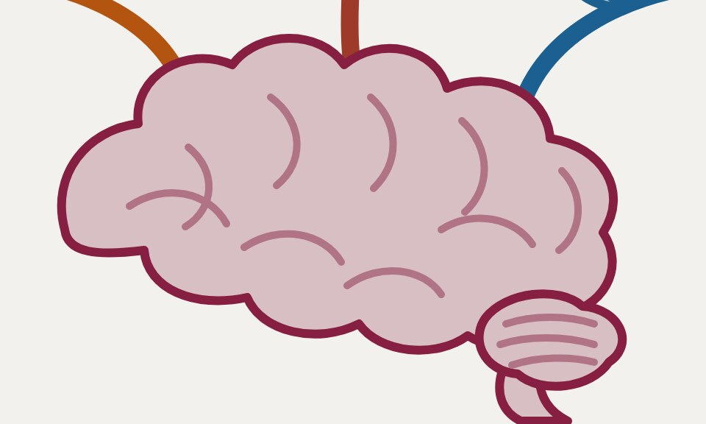
Three ideas I want to plant in your head.
Privileges and Responsibilities
The Implications of Our Work
Agency and Choice
1
2
3
20 / 28
Notes:
The map for the next stretch, put up right after “so what do we do with that?” — three things to plant, then the rest of the deck waters each one. Name them plainly, one step at a time, and don’t argue for any of them here; each has its own slides. Then leave all three up for a beat before moving on.

Slide 77
What do you tell people about ethics in one of the most clearly virtuous jobs — being a doctor?
21 / 28
Notes:
Open on the veil and actually ask the question — doctors are the profession everyone grants is virtuous, so what is there even to say? Then advance: the veil lifts and this is what got said. The whole point of her line is that it does not conclude “so quit.” It concludes “so you owe something.” Let the gloss land, then advance — the next slide turns the same sentence on you.

Slide 78

"You have the privilege to make a lucrative living off the backs of the sick and dying."
21 / 28
Notes:
Open on the veil and actually ask the question — doctors are the profession everyone grants is virtuous, so what is there even to say? Then advance: the veil lifts and this is what got said. The whole point of her line is that it does not conclude “so quit.” It concludes “so you owe something.” Let the gloss land, then advance — the next slide turns the same sentence on you.

Slide 79
"You have the privilege to make a lucrative living off the backs of the sick and dying."
Not an argument against becoming a doctor. An argument that it is a privilege — and that a privilege carries a responsibility.
21 / 28
Notes:
Open on the veil and actually ask the question — doctors are the profession everyone grants is virtuous, so what is there even to say? Then advance: the veil lifts and this is what got said. The whole point of her line is that it does not conclude “so quit.” It concludes “so you owe something.” Let the gloss land, then advance — the next slide turns the same sentence on you.

Slide 80

I have the privilege to make a lucrative living off the backs of the young — the financially and intellectually vulnerable.
— me
22 / 28
Notes:
The sentence is on screen from the start — say your own version in your own voice and point out that the only thing that changed is the profession. Let it sit; naming your own position is what earns the right to ask them about theirs on the next slide.

Slide 81
So — on whose backs?
Same question, pointed at us. What does a software engineer make a lucrative living off?
23 / 28
Notes:
Ask the room before revealing the cards — they will get most of these. The answer isn’t abstinence; nobody here is quitting software. The answer is that you now know the bill exists and roughly who it lands on.

Slide 82

So — on whose backs?
Same question, pointed at us. What does a software engineer make a lucrative living off?
The environment
23 / 28
Notes:
Ask the room before revealing the cards — they will get most of these. The answer isn’t abstinence; nobody here is quitting software. The answer is that you now know the bill exists and roughly who it lands on.

Slide 83
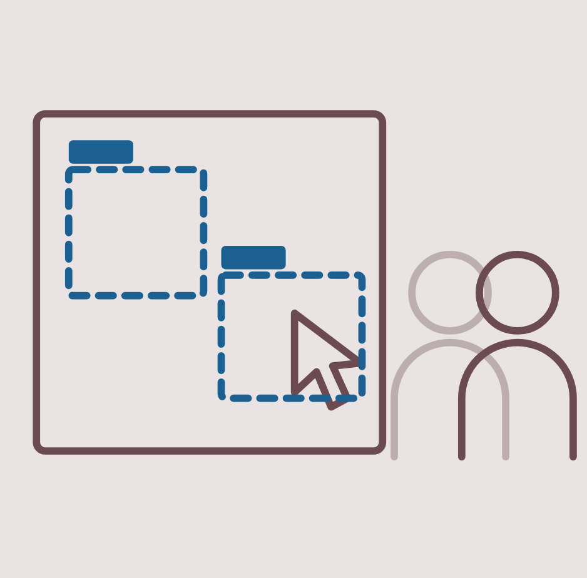
So — on whose backs?
Same question, pointed at us. What does a software engineer make a lucrative living off?
The environment
Data laborers
23 / 28
Notes:
Ask the room before revealing the cards — they will get most of these. The answer isn’t abstinence; nobody here is quitting software. The answer is that you now know the bill exists and roughly who it lands on.

Slide 84
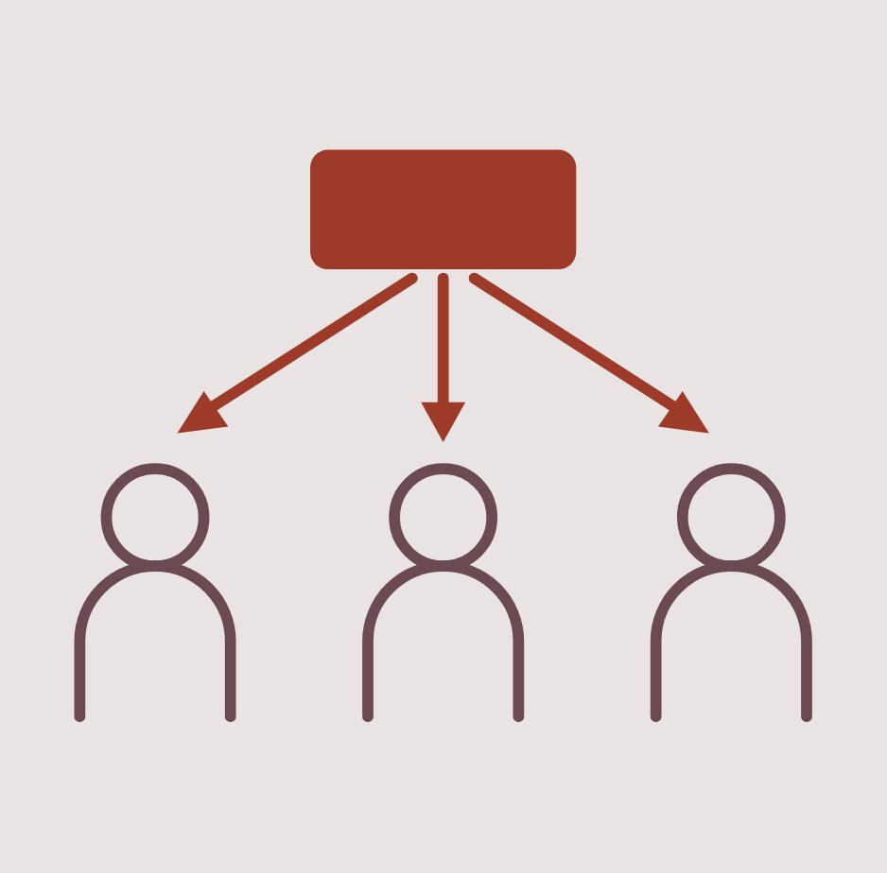
So — on whose backs?
Same question, pointed at us. What does a software engineer make a lucrative living off?
The environment
Data laborers
Everyone downstream
23 / 28
Notes:
Ask the room before revealing the cards — they will get most of these. The answer isn’t abstinence; nobody here is quitting software. The answer is that you now know the bill exists and roughly who it lands on.

Slide 85
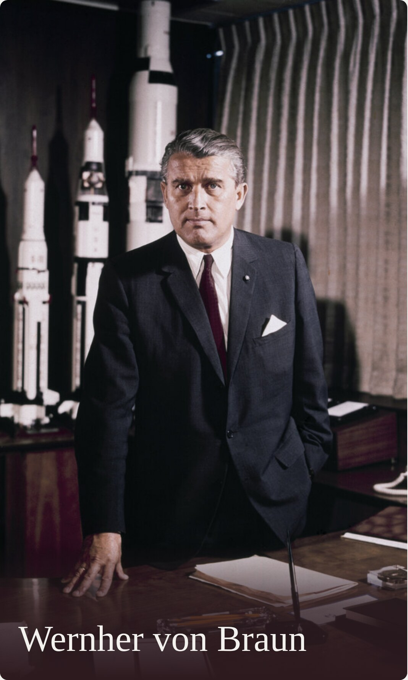

Wernher von Braun
24 / 28
Notes:
Hold on step 0 and actually ask the room — most will not place the face, a few will. Give them the Saturn V first; that is the version of him NASA put on television. Then the V-2: fired at London and Antwerp, and say plainly that the labour was slave labour — more people died building it than were killed by it. The Lehrer line is satire, not a quotation from von Braun, so say so. Then stop and let the last question sit; do not answer it. — Image credits (all public domain, no attribution required): portrait, NASA / MSFC, Fred Deaton, May 1964. Saturn V, NASA / KSC, Apollo 11 launch, 16 July 1969. V-2, UK Crown Copyright expired, Operation Backfire, Cuxhaven, October 1945.

Slide 86
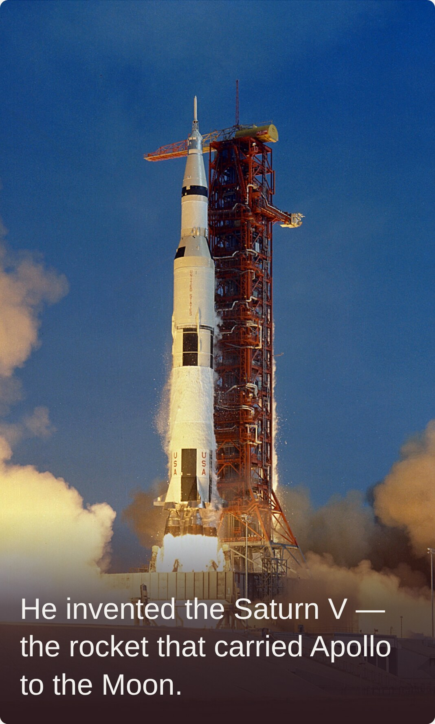
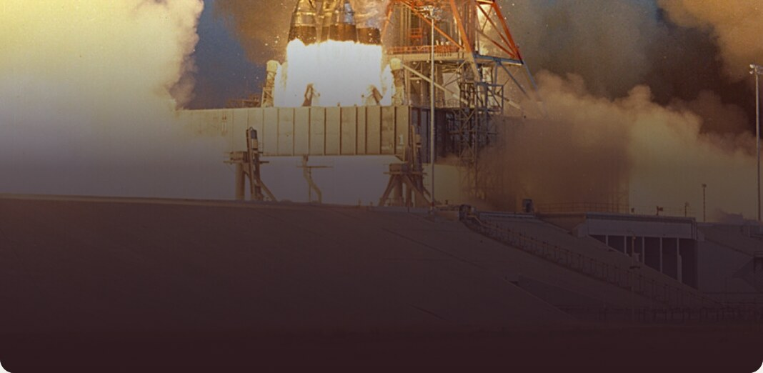
He invented the Saturn V — the rocket that carried Apollo to the Moon.
Wernher von Braun
24 / 28
Notes:
Hold on step 0 and actually ask the room — most will not place the face, a few will. Give them the Saturn V first; that is the version of him NASA put on television. Then the V-2: fired at London and Antwerp, and say plainly that the labour was slave labour — more people died building it than were killed by it. The Lehrer line is satire, not a quotation from von Braun, so say so. Then stop and let the last question sit; do not answer it. — Image credits (all public domain, no attribution required): portrait, NASA / MSFC, Fred Deaton, May 1964. Saturn V, NASA / KSC, Apollo 11 launch, 16 July 1969. V-2, UK Crown Copyright expired, Operation Backfire, Cuxhaven, October 1945.

Slide 87
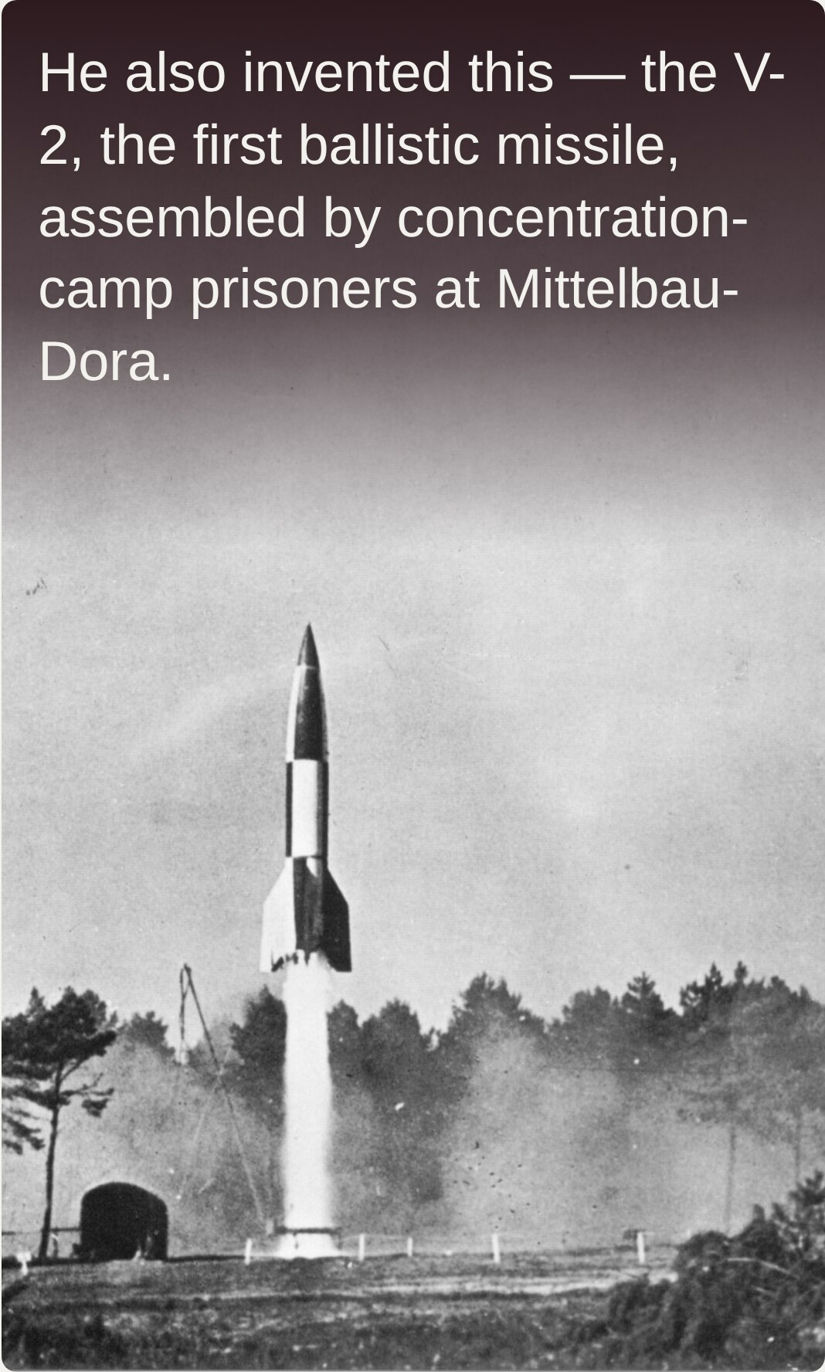

He also invented this — the V-2, the first ballistic missile, assembled by concentration-camp prisoners at Mittelbau-Dora.
He invented the Saturn V — the rocket that carried Apollo to the Moon.
Wernher von Braun
24 / 28
Notes:
Hold on step 0 and actually ask the room — most will not place the face, a few will. Give them the Saturn V first; that is the version of him NASA put on television. Then the V-2: fired at London and Antwerp, and say plainly that the labour was slave labour — more people died building it than were killed by it. The Lehrer line is satire, not a quotation from von Braun, so say so. Then stop and let the last question sit; do not answer it. — Image credits (all public domain, no attribution required): portrait, NASA / MSFC, Fred Deaton, May 1964. Saturn V, NASA / KSC, Apollo 11 launch, 16 July 1969. V-2, UK Crown Copyright expired, Operation Backfire, Cuxhaven, October 1945.

Slide 88
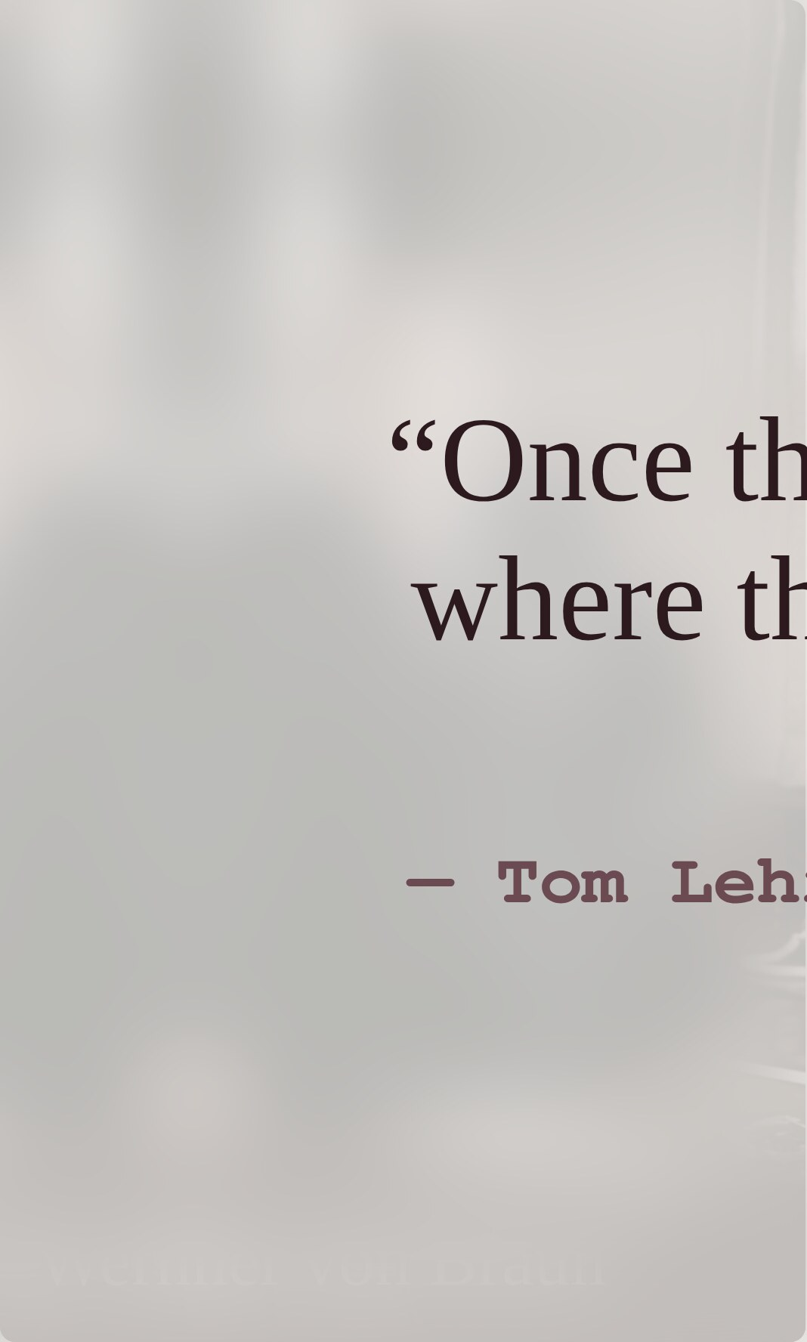
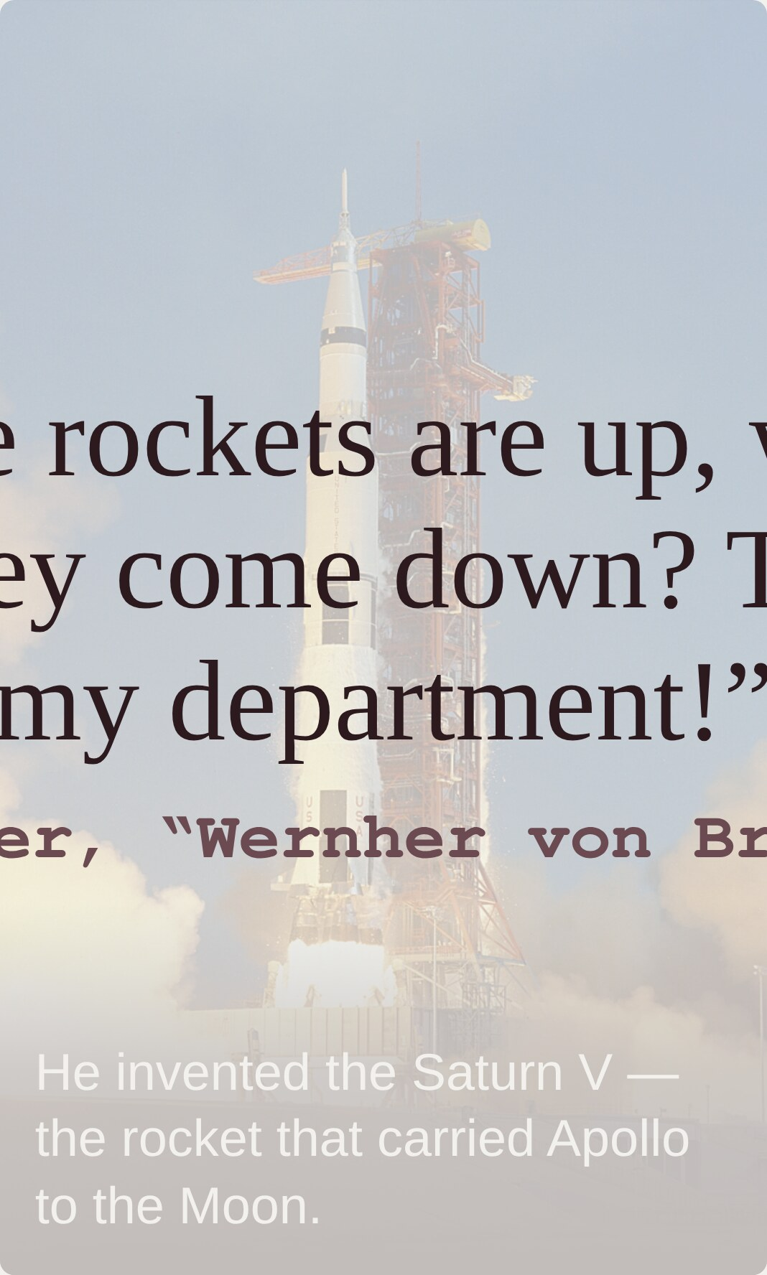
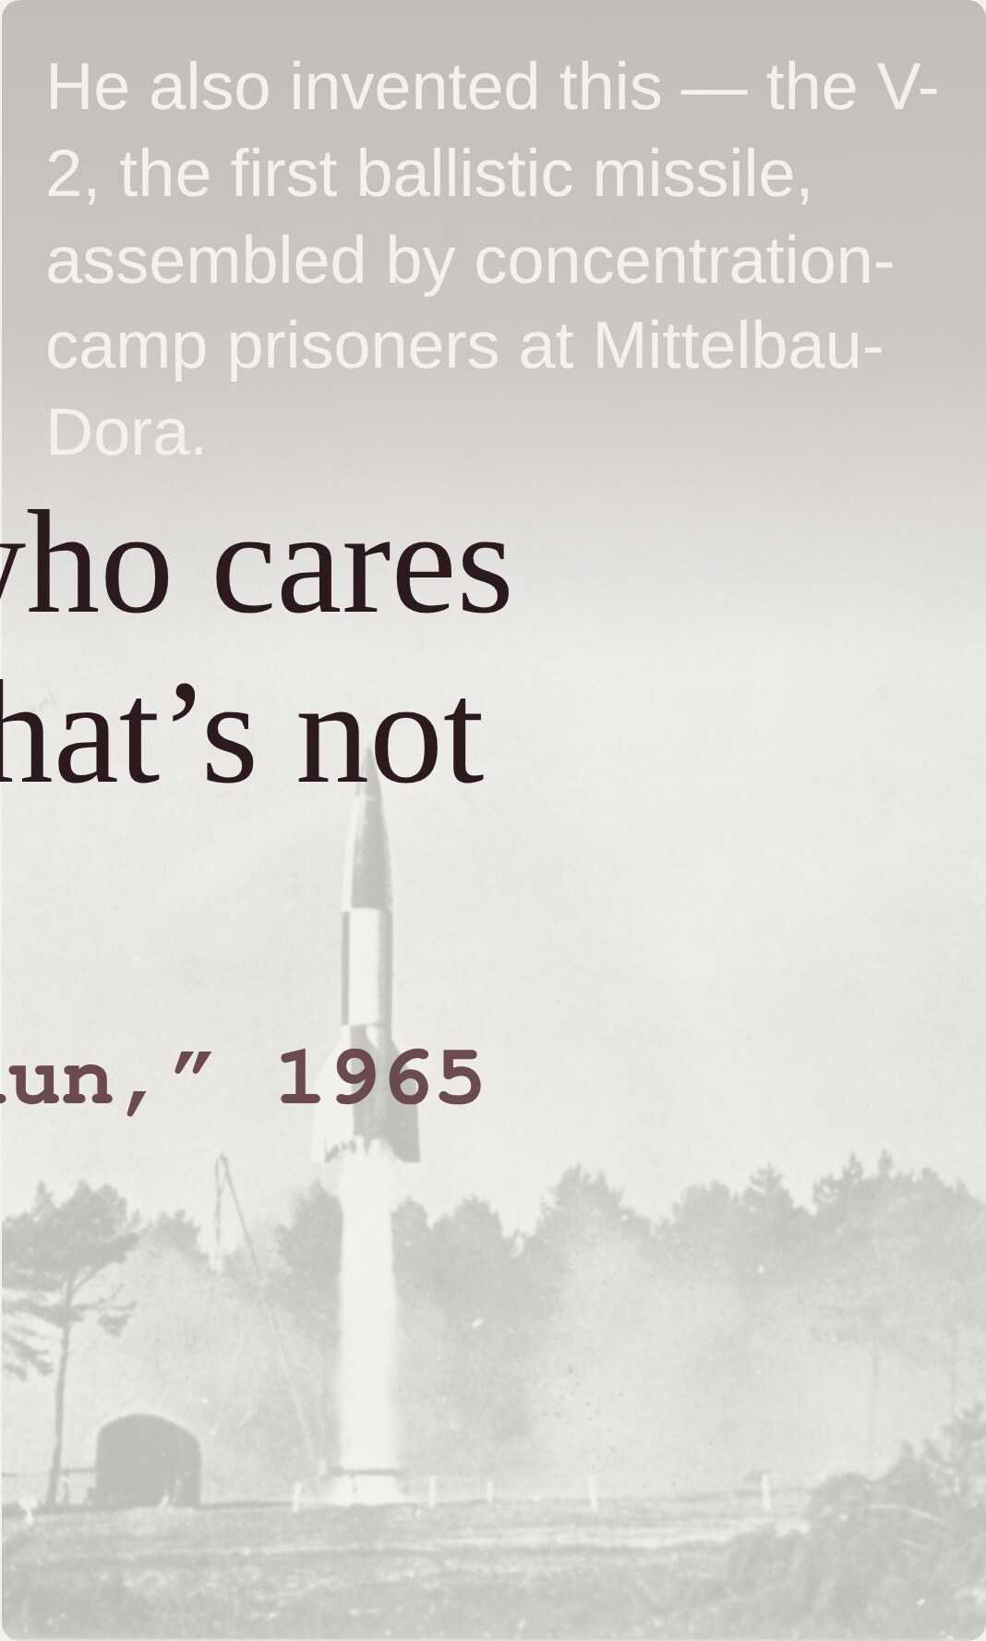

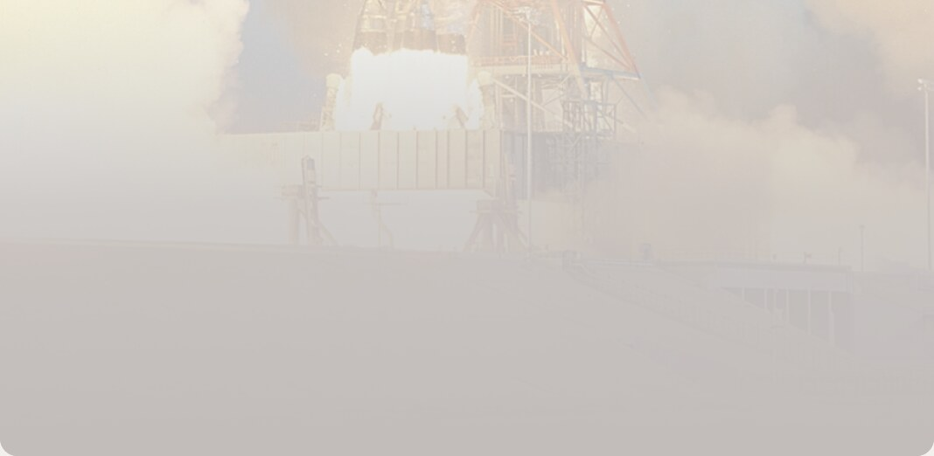

He also invented this — the V-2, the first ballistic missile, assembled by concentration-camp prisoners at Mittelbau-Dora.
“Once the rockets are up, who cares where they come down? That’s not my department!”
— Tom Lehrer, “Wernher von Braun,” 1965
He invented the Saturn V — the rocket that carried Apollo to the Moon.
Wernher von Braun
24 / 28
Notes:
Hold on step 0 and actually ask the room — most will not place the face, a few will. Give them the Saturn V first; that is the version of him NASA put on television. Then the V-2: fired at London and Antwerp, and say plainly that the labour was slave labour — more people died building it than were killed by it. The Lehrer line is satire, not a quotation from von Braun, so say so. Then stop and let the last question sit; do not answer it. — Image credits (all public domain, no attribution required): portrait, NASA / MSFC, Fred Deaton, May 1964. Saturn V, NASA / KSC, Apollo 11 launch, 16 July 1969. V-2, UK Crown Copyright expired, Operation Backfire, Cuxhaven, October 1945.

Slide 89
Move fast and break things.
— Facebook’s internal motto, 2009–2014
25 / 28
Notes:
Read the motto out loud with the weight on “and” — the speed and the breakage were always sold as a package, not a trade-off anyone agreed to. Then take it apart slowly; leave a beat between each question. The last one is the whole slide: “things” is a euphemism, and it is doing a lot of work. Connect it straight back to von Braun — same dodge, better branding.

Slide 90
Move fast and break things.
— Facebook’s internal motto, 2009–2014
Move fast — To where?
25 / 28
Notes:
Read the motto out loud with the weight on “and” — the speed and the breakage were always sold as a package, not a trade-off anyone agreed to. Then take it apart slowly; leave a beat between each question. The last one is the whole slide: “things” is a euphemism, and it is doing a lot of work. Connect it straight back to von Braun — same dodge, better branding.

Slide 91
Move fast and break things.
— Facebook’s internal motto, 2009–2014
Move fast — To where?
Break things — what are we breaking? Who owns it? Who is impacted?
25 / 28
Notes:
Read the motto out loud with the weight on “and” — the speed and the breakage were always sold as a package, not a trade-off anyone agreed to. Then take it apart slowly; leave a beat between each question. The last one is the whole slide: “things” is a euphemism, and it is doing a lot of work. Connect it straight back to von Braun — same dodge, better branding.

Slide 92


Agency
26 / 28
Notes:
Talk track: responsibility is boxes piled into your wheelbarrow — each one limits how freely you can roam. Everyone in this room has a different load already: a visa, student loan debt, family responsibilities. But everyone here is young, and whatever agency you have, it is likely the most you will ever have in your life. The career decisions you make now are the most impactful you will ever make. Step through boxes 1–5 (the bar drains with each), land the takeaway on step 6, then hit step 7 — the beard goes gray — and let it sit: this is a whole career going by with the barrow still in hand.

Slide 93
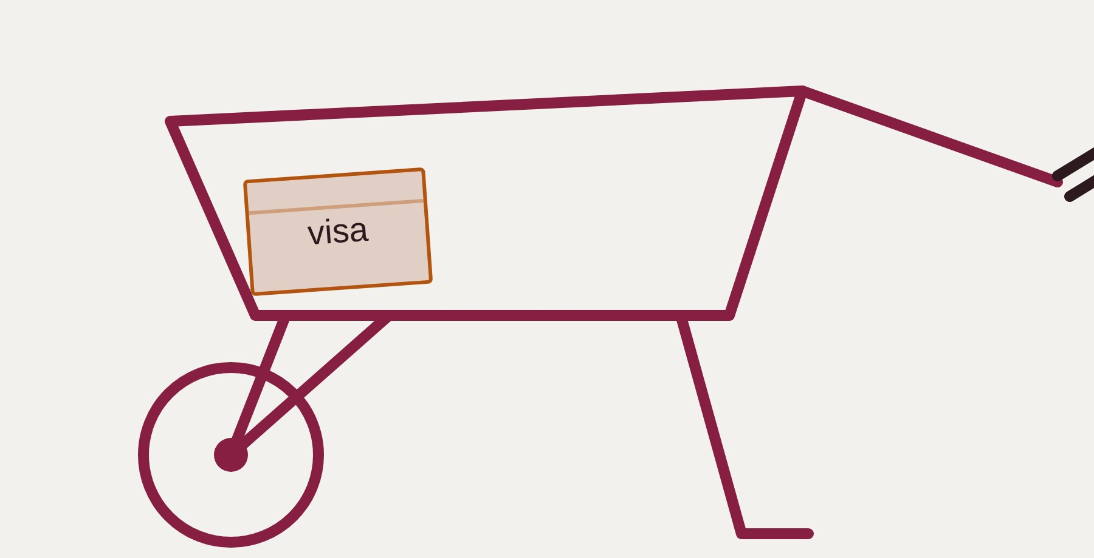
Agency
visa
26 / 28
Notes:
Talk track: responsibility is boxes piled into your wheelbarrow — each one limits how freely you can roam. Everyone in this room has a different load already: a visa, student loan debt, family responsibilities. But everyone here is young, and whatever agency you have, it is likely the most you will ever have in your life. The career decisions you make now are the most impactful you will ever make. Step through boxes 1–5 (the bar drains with each), land the takeaway on step 6, then hit step 7 — the beard goes gray — and let it sit: this is a whole career going by with the barrow still in hand.

Slide 94
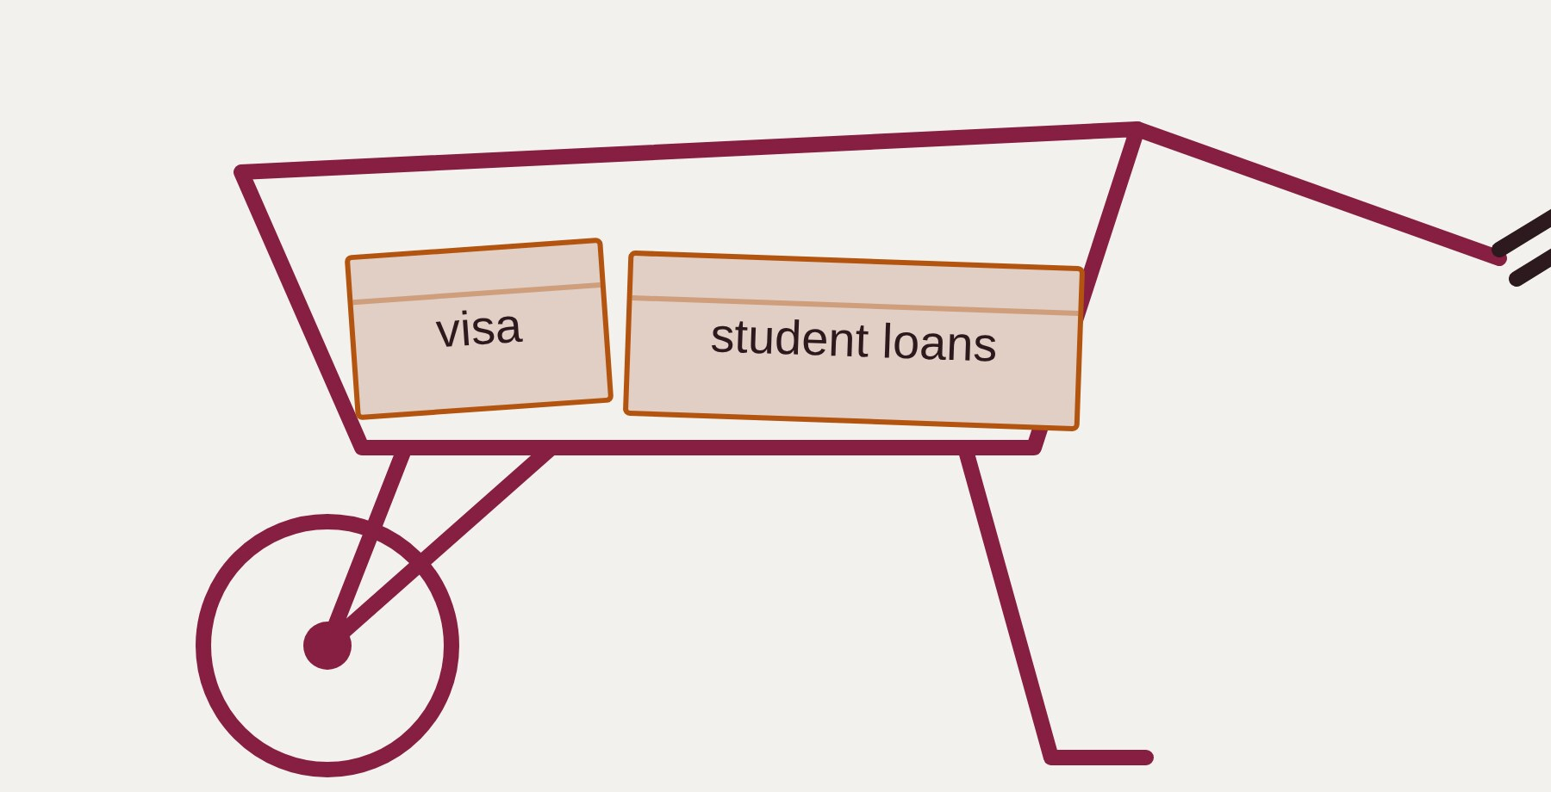
Agency
visa
student loans
26 / 28
Notes:
Talk track: responsibility is boxes piled into your wheelbarrow — each one limits how freely you can roam. Everyone in this room has a different load already: a visa, student loan debt, family responsibilities. But everyone here is young, and whatever agency you have, it is likely the most you will ever have in your life. The career decisions you make now are the most impactful you will ever make. Step through boxes 1–5 (the bar drains with each), land the takeaway on step 6, then hit step 7 — the beard goes gray — and let it sit: this is a whole career going by with the barrow still in hand.

Slide 95
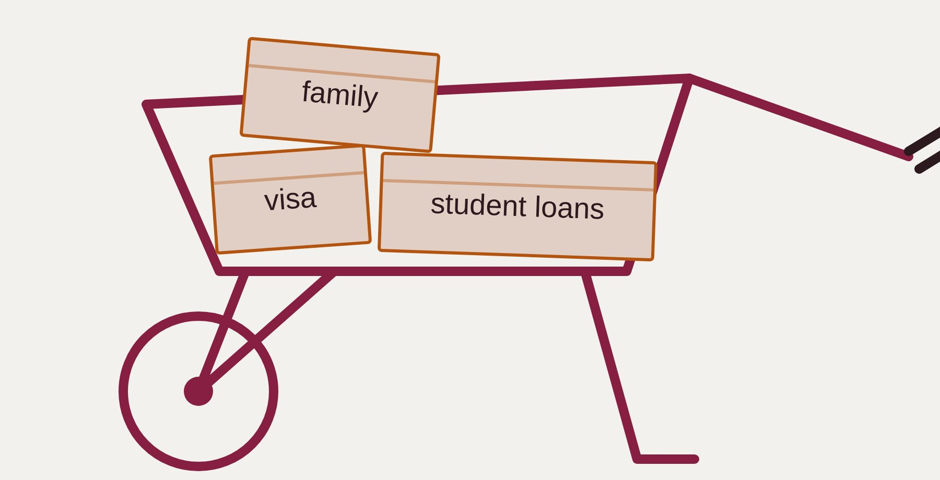
Agency
family
visa
student loans
26 / 28
Notes:
Talk track: responsibility is boxes piled into your wheelbarrow — each one limits how freely you can roam. Everyone in this room has a different load already: a visa, student loan debt, family responsibilities. But everyone here is young, and whatever agency you have, it is likely the most you will ever have in your life. The career decisions you make now are the most impactful you will ever make. Step through boxes 1–5 (the bar drains with each), land the takeaway on step 6, then hit step 7 — the beard goes gray — and let it sit: this is a whole career going by with the barrow still in hand.

Slide 96
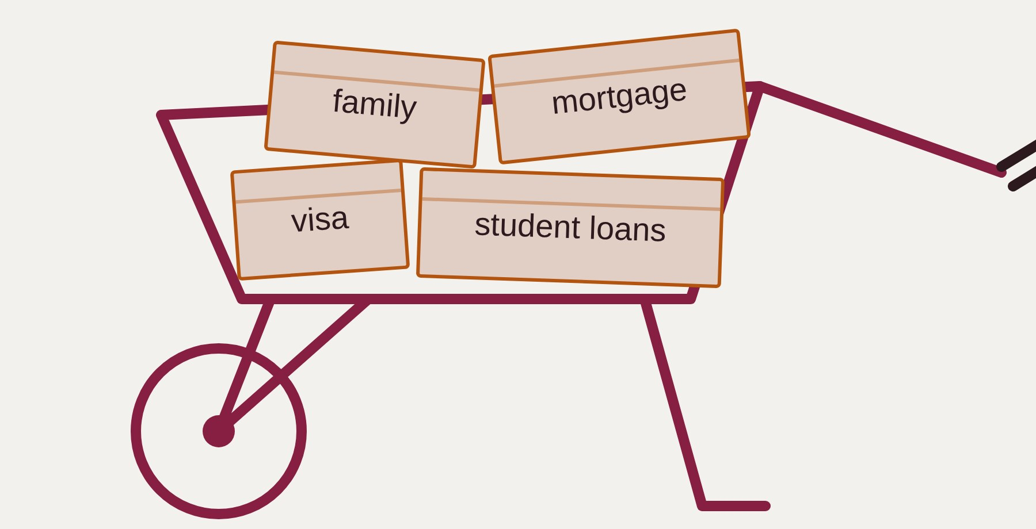
Agency
family
mortgage
visa
student loans
26 / 28
Notes:
Talk track: responsibility is boxes piled into your wheelbarrow — each one limits how freely you can roam. Everyone in this room has a different load already: a visa, student loan debt, family responsibilities. But everyone here is young, and whatever agency you have, it is likely the most you will ever have in your life. The career decisions you make now are the most impactful you will ever make. Step through boxes 1–5 (the bar drains with each), land the takeaway on step 6, then hit step 7 — the beard goes gray — and let it sit: this is a whole career going by with the barrow still in hand.

Slide 97
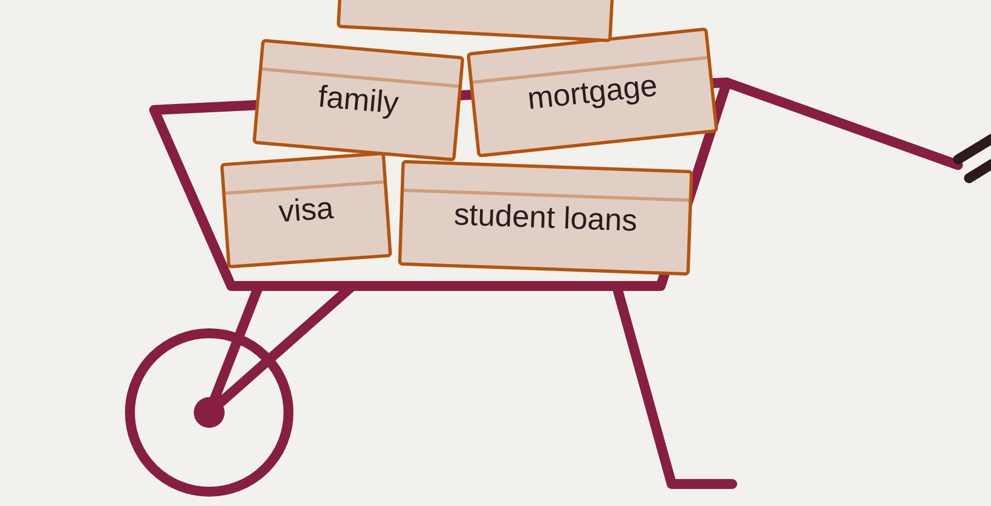
Agency
expectations
family
mortgage
visa
student loans
26 / 28
Notes:
Talk track: responsibility is boxes piled into your wheelbarrow — each one limits how freely you can roam. Everyone in this room has a different load already: a visa, student loan debt, family responsibilities. But everyone here is young, and whatever agency you have, it is likely the most you will ever have in your life. The career decisions you make now are the most impactful you will ever make. Step through boxes 1–5 (the bar drains with each), land the takeaway on step 6, then hit step 7 — the beard goes gray — and let it sit: this is a whole career going by with the barrow still in hand.

Slide 98
Agency
Everyone has different levels of agency. But everyone has some agency.
expectations
family
mortgage
visa
student loans
26 / 28
Notes:
Talk track: responsibility is boxes piled into your wheelbarrow — each one limits how freely you can roam. Everyone in this room has a different load already: a visa, student loan debt, family responsibilities. But everyone here is young, and whatever agency you have, it is likely the most you will ever have in your life. The career decisions you make now are the most impactful you will ever make. Step through boxes 1–5 (the bar drains with each), land the takeaway on step 6, then hit step 7 — the beard goes gray — and let it sit: this is a whole career going by with the barrow still in hand.

Slide 99
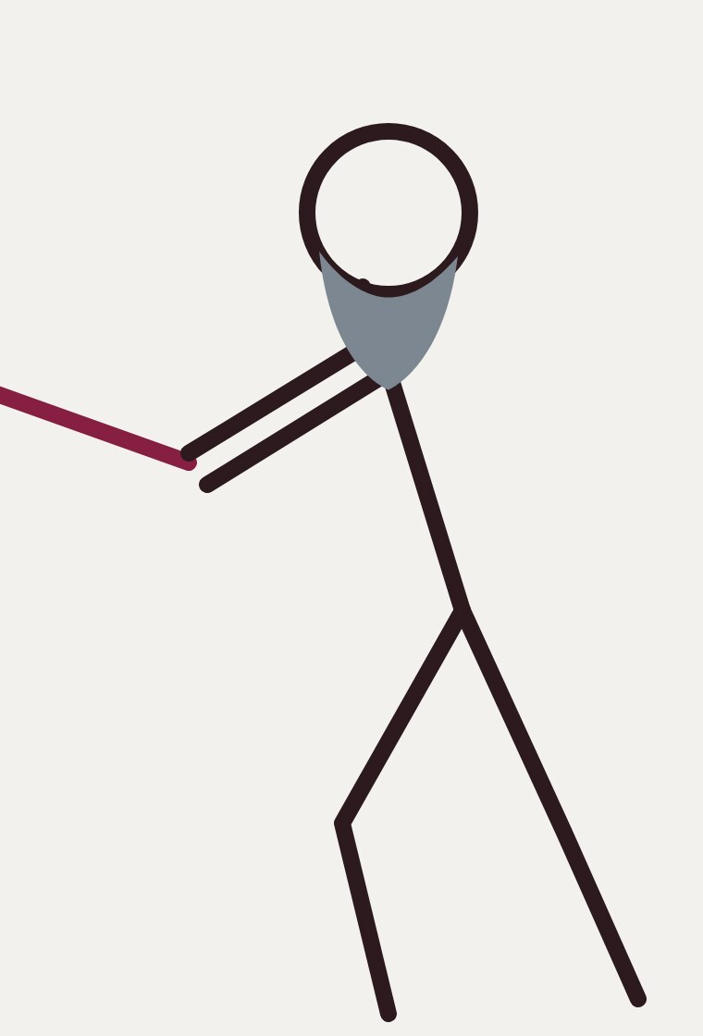

Agency
Everyone has different levels of agency. But everyone has some agency.
expectations
family
mortgage
visa
student loans
26 / 28
Notes:
Talk track: responsibility is boxes piled into your wheelbarrow — each one limits how freely you can roam. Everyone in this room has a different load already: a visa, student loan debt, family responsibilities. But everyone here is young, and whatever agency you have, it is likely the most you will ever have in your life. The career decisions you make now are the most impactful you will ever make. Step through boxes 1–5 (the bar drains with each), land the takeaway on step 6, then hit step 7 — the beard goes gray — and let it sit: this is a whole career going by with the barrow still in hand.

Slide 100
Decide where to move and get there thoughtfully.
— the same motto, rewritten
27 / 28
Notes:
Callback to the Facebook motto, now that agency is on the table: same sentence shape, but each half answers the question the original dodged — “to where?” becomes deciding where to move; “break things” becomes getting there thoughtfully. Read it once, plainly, and move on — the closing slide does the rest.

Slide 101


Thanks! Questions?
28 / 28

